Slide 1
Artificial Intelligence
Dr. O. I. Adelaiye

Slide 2
Understanding Natural Language
Lecture 2

Slide 3
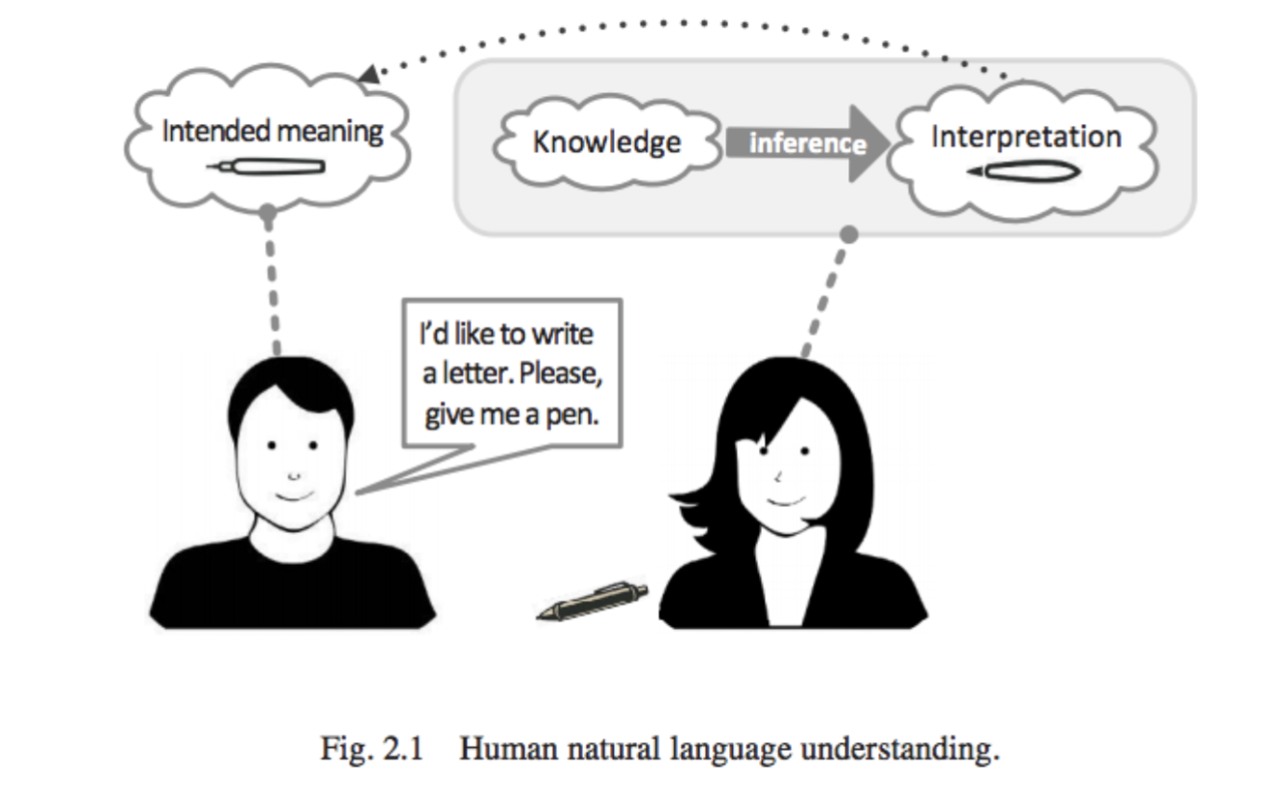
Understanding Natural Language

Slide 4
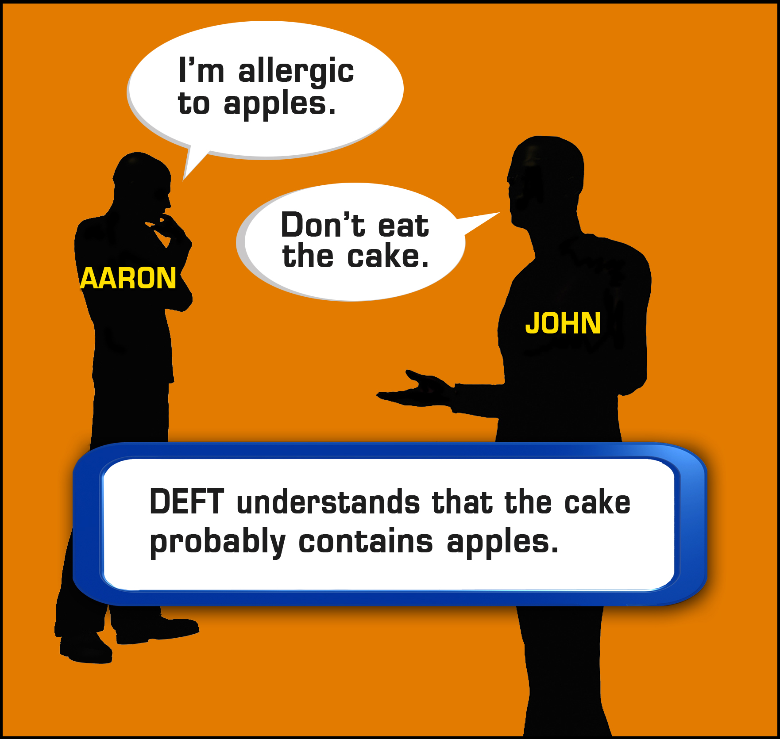
DEFT: - Deep Exploration and Filtering of Text

Slide 5
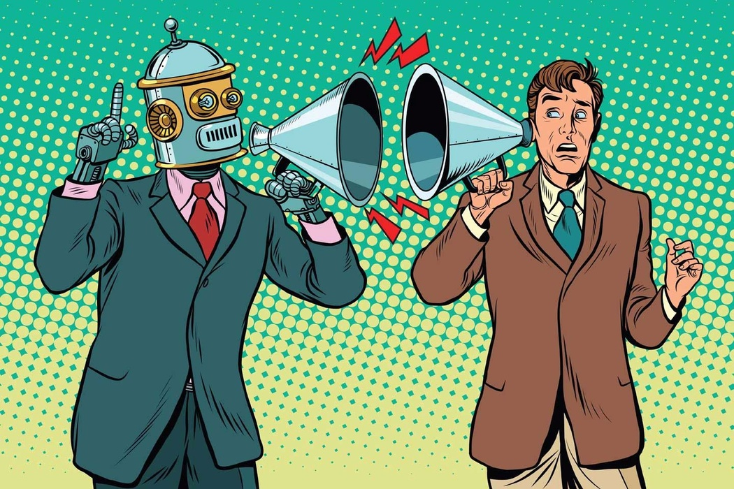

Slide 6
We like to imagine talking to computers the way Detective Del Spooner spoke to Sonny in Irobot, but in reality, natural language processing is more than just teaching a computer to understand words.
The subtext of how and why we use the words we do is notoriously difficult for computers to comprehend. Instead of Data, we get frustrations with our assistants and endless jokes.

Slide 7
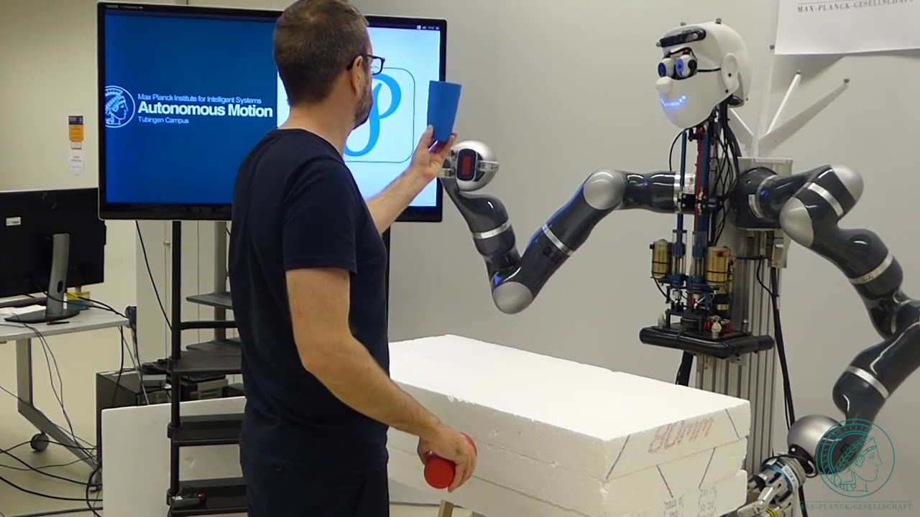

Slide 8


Slide 9
Understanding Natural Language
Have you ever asked: “Google, what’s the weather like outside?” or “Siri, how is the traffic this morning?”
If yes, you would have received a data-supported answer from your portable device or mobile phone.

Slide 10
Understanding Natural Language
Just how can it understand that you are interested in knowing the weather in a specific location or the traffic on the exact route that you travel every morning?
The answer is NLU: Natural language understanding.

Slide 11
Understanding Natural Language
This artificial intelligence centered automation enables voice technology, like Siri, Cortana, Alexa and Google’s Assistant, to deduce what you actually mean, regardless of the way you express it.

Slide 12
Understanding Natural Language
This technology is being improve everyday into more languages on the part of the humans and taking into account wider ranges of intonations

Slide 13
Definition
The comprehension by computers of the structure and meaning of human language (e.g., English, Spanish, Japanese, hausa), allowing users to interact with the computer using natural sentences”.

Slide 14
Definition
In other words, NLU is Artificial Intelligence that uses computer software to interpret text and any type of unstructured data.
NLU can digest a text, translate it into computer language and produce an output in a language that humans can understand.

Slide 15
NLU VS NLP
NLU and natural language processing (NLP) are often confused. Instead they are different parts of the same process of natural language elaboration.
NLU is a component of NLP. More precisely, it is a subset of the understanding and comprehension part of natural language processing.

Slide 16
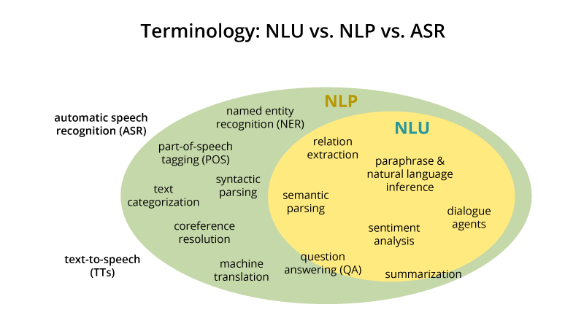

Slide 17
NLU vs NLP
Natural language understanding interprets the meaning that the user communicates and classifies it into proper intents.
For example, it is relatively easy for humans who speak the same language to understand each other, although mispronunciations, choice of vocabulary or phrasings may complicate this.

Slide 18
NLU vs NLP
NLU is responsible for this task of distinguishing what is meant by applying a range of processes such as text categorization, content analysis and sentiment analysis, which enables the machine to handle different inputs.

Slide 19
NLU vs NLP
On the other hand, natural language processing is an umbrella term to explain the whole process of turning unstructured data into structured data.
NLP helps technology to engage in communication using natural human language. As a result, we now have the opportunity to establish a conversation with virtual technology in order to accomplish tasks and answer questions.

Slide 20
History of NLU
1950: Beginning of NLU
1970-80s: Linguist began to code
Linguistics experts started to contribute to NLU, by “coding” all grammar and semantic rules.
1990-2015: Statistical revolution in Natural Language Processing.
The majority of the models in NLP now include what is called today “Machine Learning”. It is a probability model. The more you give data, the more efficient the model is.

Slide 21


Slide 22
Test Code

